Slide 1
AgroTrack
PIP2001 Capstone Project
Review-0
Batch Number: CIT-G33
Roll Number | Student Name
20211CIT0110 | S P BRAHMA CHAITANYA
20211CIT0156 | BHUVANESHWAR Y
20211CIT0147 | SHREYANKA B L
20211CIT0069 | DHANUSH M
Under the Supervision of,
Dr. Nihar Ranjan Nayak
Associate Professor
School of Computer Science and Engineering
Presidency University
Name of the Program: Capstone Project-PIP2001
Name of the HoD: Dr. Anandaraj S P
Name of the Program Project Coordinator: Dr. Sharmasth Vali Y
Name of the School Project Coordinators: Dr. Sampath A K / Dr. Abdul Khadar A / Mr. Md Ziaur Rahman

Slide 2
Content
Problem Statement
Analysis of Problem Statement
Timeline of the Project
References

Slide 3
Problem Statement Number: PSCS59
Organization: Mahindra&Mahindra(FarmEq)
Category (Hardware / Software / Both) : Software
Problem Description:
“How can a farmer gain access to all the elements of his farming cycle? one stop shop where he has access to information from different aggregators, for retailing , leasing & finally taking his produce to the nearest mandi. Application to provide a means of easy transaction for all his farming activities and his personal expenses. Agri credit should help him buy/lease Farm Machinery & have access to all the local vendors for his plantation needs including expert advice from the local university.”
Difficulty Level: Complex

Slide 4
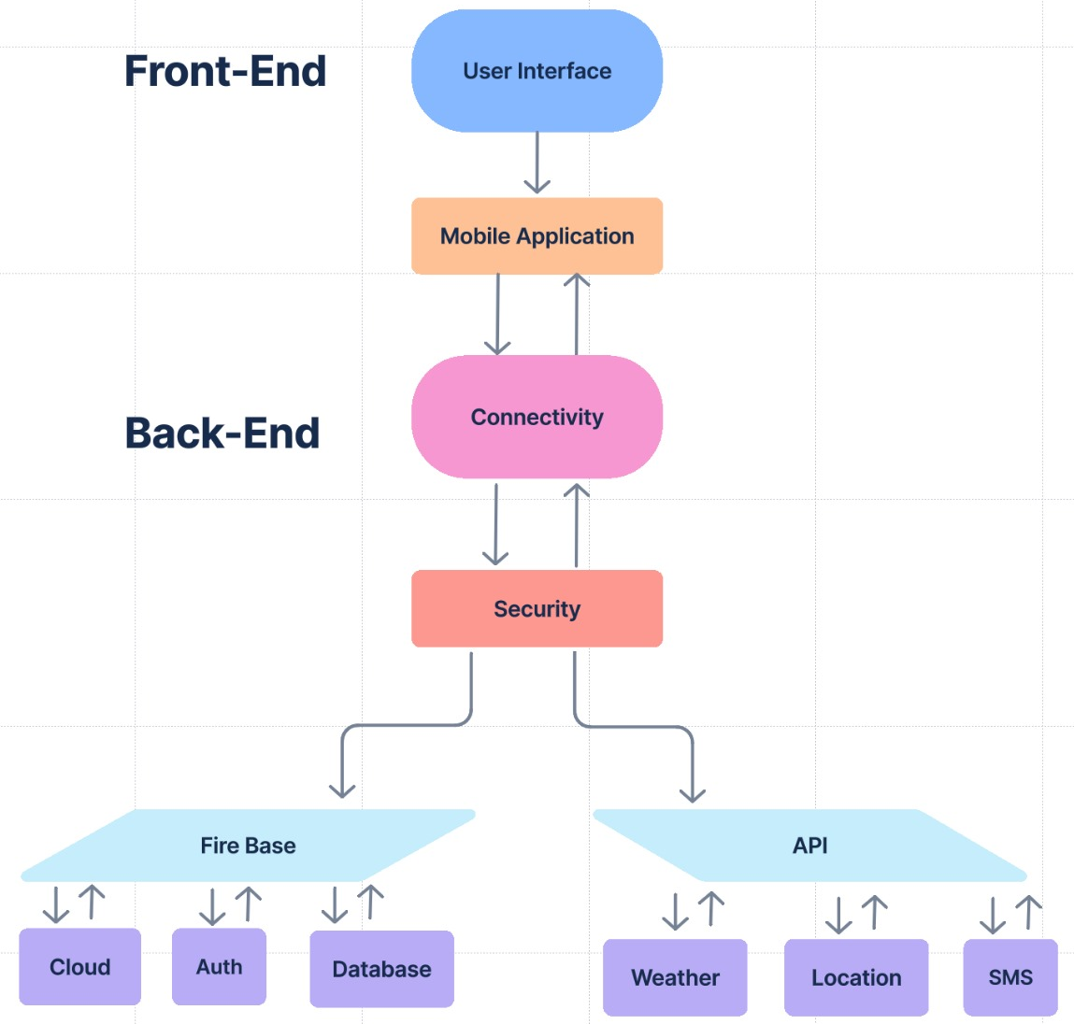
Analysis of Problem Statement
Technology Stack Components:
Front-End:
User Interface
Mobile Application
Back-End:
Connectivity Layer
Security Layer
Firebase
API’s

Slide 5
Software Requirements:
1. Development Platform:
IDE: Android Studio (used for building and testing the app).
Programming Language: Java (primary language for Android app development).
Gradle: For project build automation and dependency management.
2. API Integration:
RESTful APIs: To integrate external services like weather updates, market prices, etc.
Google Maps API: For geolocation features to locate the nearest mandi (marketplace) or other relevant locations.
Agricultural APIs: APIs that provide real-time crop recommendations based on weather, soil conditions, and location.
3. Authentication and Security:
Firebase Authentication: For secure user login and registration, including options like Google Sign-in, OTP-based authentication, or email verification.
SSL Encryption: For securing all communications and transactions between the app and the server, ensuring data privacy and protection.

Slide 6
4. Database:
Firebase Firestore: A cloud-based NoSQL database to store user data, market listings, transactions, and related information in real-time.
MySQL (optional): For local or offline data storage when required, ensuring seamless app usage in regions with limited internet connectivity.
5. Backend Services:
Firebase Cloud Functions: Serverless functions to handle backend logic such as notifications, user request processing, or generating estimates for Agri Credit.
Firebase Cloud Messaging (FCM): For sending real-time push notifications about market prices, updates, new deals from vendors, etc.
6. Analytics and Monitoring:
Firebase Analytics: To monitor user engagement, app performance, and behavior, providing insights for improving app functionality.
Firebase Crashlytics: For tracking app crashes in real-time, identifying bugs, and ensuring stability.

Slide 7
Hardware Requirements:
None: This project is entirely software-based and does not require any specific hardware for its functionality.
Basic Laptop: For developing and testing the app using Android Studio.
Android Phone: For testing the application on a real device to ensure proper functionality and user experience.

Slide 8
Key Features of the App:
1. Crop Recommendations Based on Weather:
The app suggests the best crops to grow at any given time, considering the current temperature and weather conditions of the farmer's location.
2. Access to Local and International Markets:
The app connects farmers with both local and wholesale markets, within India and internationally, enabling them to sell their produce directly without relying on brokers.
3. Market-based Price Suggestions:
The app suggests prices for grown crops by considering real-time market data, enabling farmers to understand the actual value of their produce.

Slide 9
4. Farming Tips with Advanced Technology:
The app provides tips and guidance on using new technologies to increase farm efficiency and yield, helping farmers adopt modern farming methods for better results.
5. Secure Authentication:
The app ensures secure access through proper authentication by verifying government-issued farmer IDs and address proof, preventing fake users from accessing the platform.
6. Agri Credit and Loan Support:
By assessing the farmer's needs for new technology and machinery, the app creates a detailed estimate and sends it to the farmer's home branch. This enables farmers to apply for government-backed loans, helping them adopt advanced farming equipment and techniques.

Slide 10
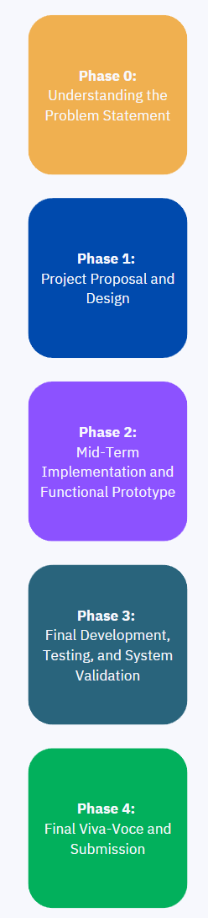
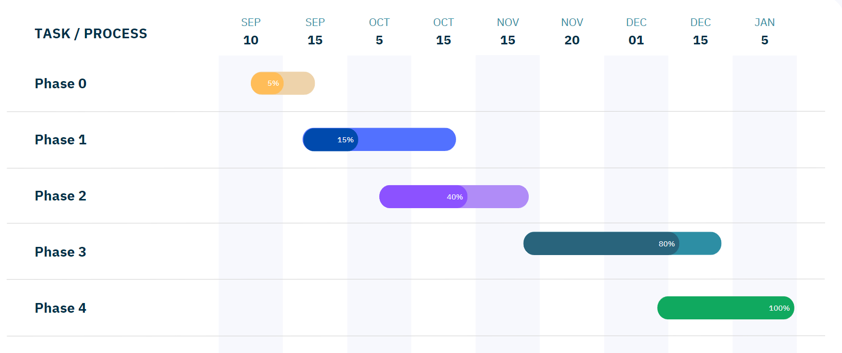
Project Timeline (Gantt Chart)

Slide 11
References (IEEE Paper)
Magno, L. P., & Moraes, M. L. (2020). Internet-of-Things (IoT)-based smart agriculture: Toward making the fields talk. IEEE Access. Summary: This paper explores IoT applications in agriculture, enhancing decision-making via real-time data from sensors, aligning with your app’s weather data and crop recommendations.
Silva, J. L., & De Souza, M. C. (2019). A farmer’s mobile market: Agricultural e-commerce. IEEE Transactions on E-Commerce. Summary: This paper focuses on e-commerce solutions for agricultural products, aligning with your app’s market connection features for farmers globally.
Sharma, A. N., & Verma, K. (2021). Smart agricultural data management system. IEEE Systems Journal. Summary: This paper discusses data management systems for agriculture, similar to your app's market listings, crop prices, and vendor details.
Patel, P. S., & Jain, R. K. (2018). Mobile applications for farmer market and crop forecasting. IEEE Mobile Computing. Summary: This paper covers mobile apps for connecting farmers to markets and crop forecasting, aligning with your app’s functionalities for market and crop sale.
Singh, D. A., & Kumar, A. (2022). Machine learning and data analytics in precision agriculture. IEEE Transactions on AI. Summary: This paper focuses on the use of machine learning for crop yield predictions, relevant to your app’s feature for technology-enhanced farming practices.

Slide 12


